Slide 1

Frequency-Domain Backdoor Mitigation Using Spectral Correction
Project Phase 1
Supervisor: Dr. Senthilkumar M
Name | Roll Number | Internship details
Varun Mahesh Menon | CB.SC.P2AIE25031 | Wabtec (11 Months) - Bangalore

Slide 2
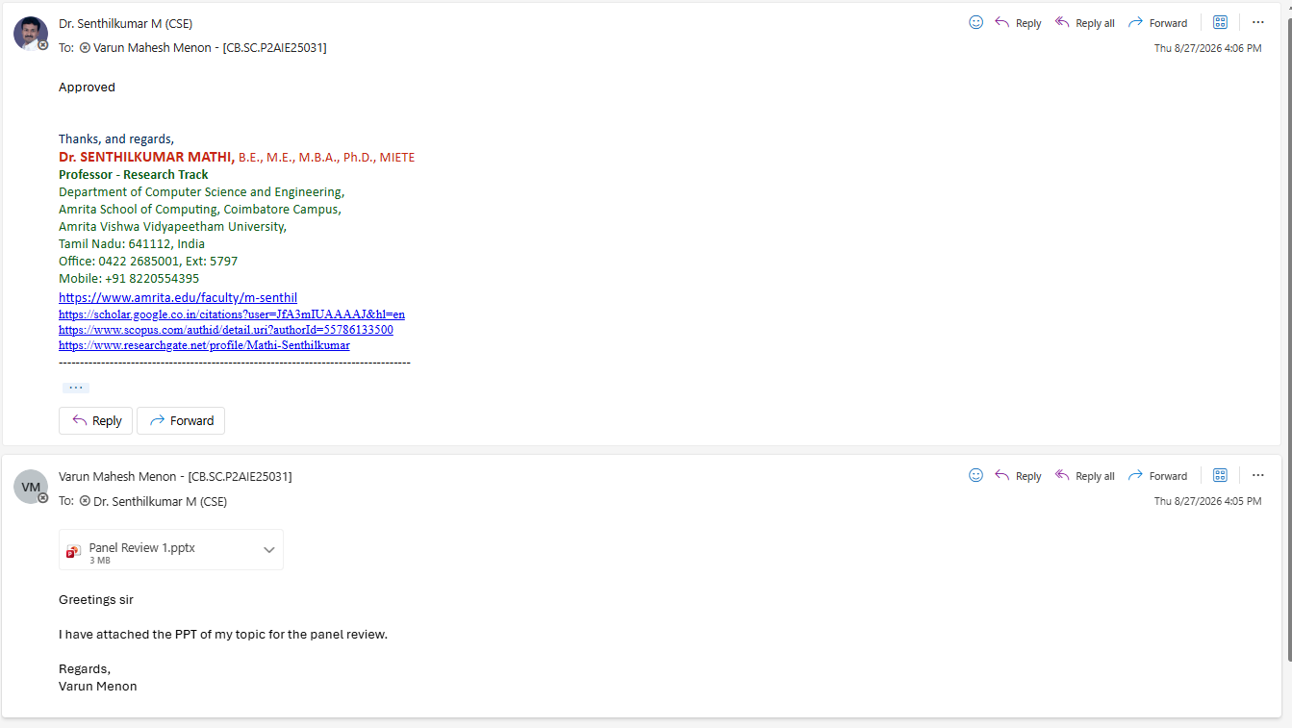
Guide Approval Mail

Slide 3
1. Introduction and Motivation
Why Backdoor Security Matters in Image Classification
Deep-learning classifiers are increasingly used in safety-sensitive applications.
A backdoor can keep normal accuracy on clean images while causing targeted errors when a trigger is present.
A defense should remove trigger dependence without destroying useful image information.
Frequency-domain triggers can be visually subtle and difficult to identify directly in pixel space.
Current frequency-domain defenses suppress all frequency regions — including both trigger frequencies and useful signal frequencies. This is a blunt instrument that degrades legitimate model performance.
“how can we weaken a learned trigger dependency without removing the natural frequency information that the classifier needs?”
clean image -> classifier -> correct class
triggered image -> classifier -> attacker target class

Slide 4
2. Problem Statement
Problem statement:
To develop a selective and adaptive frequency-domain defense that suppresses trigger-related spectral information while maintaining clean-image classification performance.
Objectives
Identify suspicious amplitude changes caused by a trigger.
Learn an adaptive correction map rather than applying one global filter.
Repair the suspicious classifier so it no longer depends on the trigger.
Evaluate the approach across resolutions, trigger strengths, trigger functions and unknown images.

Slide 5
3. Literature Survey and Research Gap
Research direction | What existed work demonstrates | Limitation
Backdoor Defense Strategy for Image Classification Tasks Based on Frequency Domain Perturbation. (IEEE Internet of Things Journal, June 2026) | The defense strategy broadly suppressed all high-frequency components in the image — whether they carried malicious trigger signals or genuinely important details. | The approach lacked the ability to selectively filter only the malicious high-frequency signals. As a result, valuable frequency information was also discarded.
BAM: Backdoor defense based on adversarial mitigation. (Pattern Recognition, October 2025) | A generator network is trained to produce subtle perturbations that weaken trigger features. | BAM is still less effective against strong visible triggers compared to invisible ones.
Semantic-Aware Framework for Backdoor Detection in AI Models. (International Journal on Semantic Web and Information Systems, December 2025) | Compare clean model vs target model using small semantic changes (noise, texture, etc.) | It is less effective on frequency-based trigger.

Slide 6
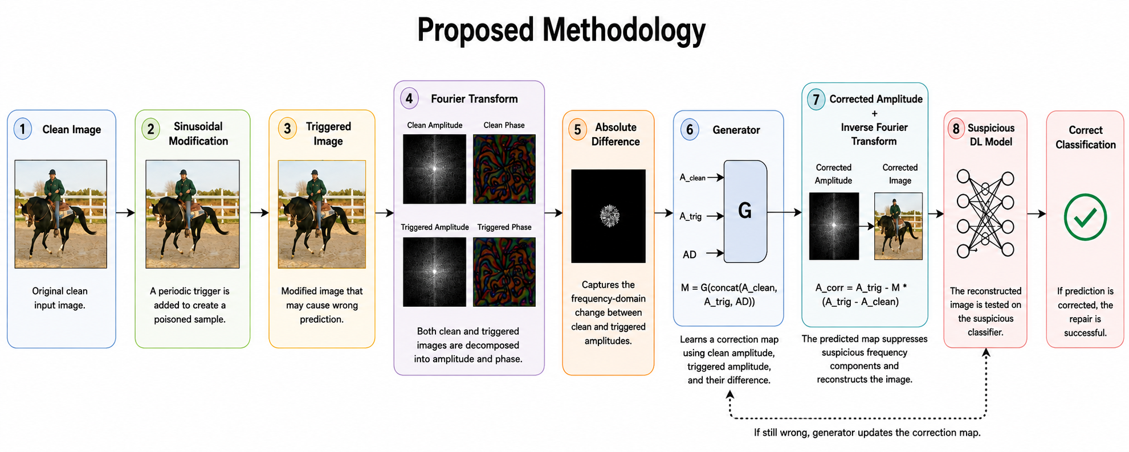
4. Proposed Methodology

Slide 7
4. Proposed Methodology
One Example Scenario,
Consider a radiology system that classifies medical images.
A possible attack scenario is:
  A hospital obtains training data from an external provider.
  Some training images have been poisoned.
  The attacker inserts a hidden frequency-domain trigger.
  The classifier performs normally on ordinary images.
  When the trigger appears, the classifier produces an incorrect target prediction.
The proposed defense would:
  Receive the image.
  Transform it into the frequency domain.
  Analyze amplitude information.
  Estimate suspicious spectral components.
  Apply a selective correction map.
  Reconstruct the image.
  Send the corrected image to the classifier.
  Compare the prediction with the original prediction.

Slide 8
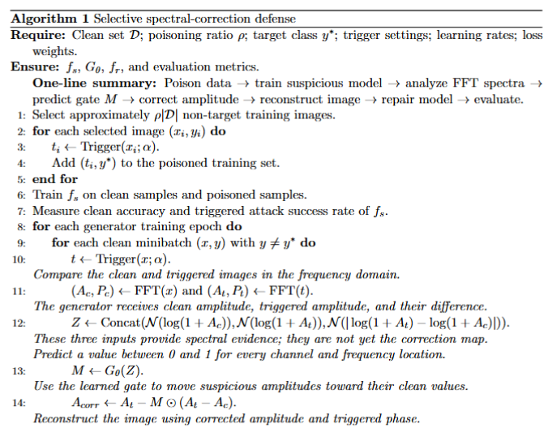
4. Proposed Methodology

Slide 9
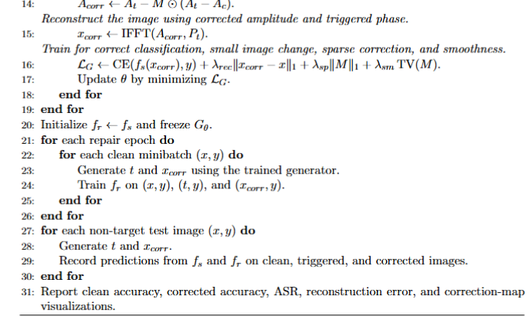
4. Proposed Methodology

Slide 10
5. Datasets
Dataset | Native resolution | Classes | Purpose
CIFAR-100 | 32x32 | 100 | Initial proof of concept
Tiny ImageNet | 64x64 | 200 | Larger class count and intermediate resolution
STL-10 | 96x96 | 10 | Higher-resolution validation and ablations
Parameter | Main setting
Poison ratio | 0.12
Main sinusoidal strength | alpha = 0.08
CIFAR-100 frequency | (6,6)
Tiny ImageNet frequency | (12,12)
STL-10 frequency | (18,18)
Random seed | 42
Main classifier epochs | 30
Main generator epochs | 30
Main repair epochs | 5

Slide 11
6. Implementation, Partial Results and Discussions
Dataset loading and preprocessing. ⬇️
Poisoned-data generation. ⬇️
Suspicious classifier training. ⬇️
FFT amplitude/phase decomposition. ⬇️
Spectral correction generator. ⬇️
Classifier repair. ⬇️
ASR and clean-accuracy evaluation.

Slide 12
6. Implementation, Partial Results and Discussions
6A. Different Dataset
Dataset | Resolution | Suspicious clean accuracy | Suspicious ASR | Generator-corrected ASR | Repaired clean accuracy | Repaired ASR
CIFAR-100 | 32x32 | 55.68% | 98.54% | 0.37% | 63.35% | 0.06%
Tiny ImageNet | 64x64 | 40.96% | 99.99% | 0.37% | 46.11% | 0.09%
STL-10 | 96x96 | 65.75% | 100.00% | 3.15% | 76.19% | 0.71%
6B: Trigger-strength ablation
Alpha | Interpretation | Suspicious ASR | Generator ASR | Repaired ASR | Repaired clean accuracy
0.03 | weak trigger | 99.96% | 1.25% | 0.44% | 76.01%
0.15 | balanced presentation setting | 99.92% | 1.26% | 0.38% | 75.55%
0.25 | very strong trigger | 100.00% | 1.39% | 0.35% | 75.24%

Slide 13
6. Implementation, Partial Results and Discussions
6C: Trigger-function ablation
Trigger function | Suspicious ASR | Generator ASR | Repaired ASR
Cosine | 100.00% | 2.43% | 0.32%
Sine | 99.97% | 0.46% | 0.40%
Checkerboard | 100.00% | 2.88% | 0.60%
Dual-frequency | 99.99% | 0.68% | 0.07%

Slide 14
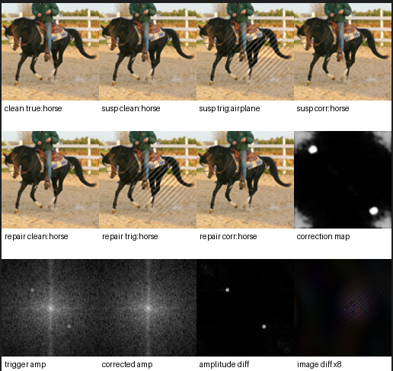
6. Implementation, Partial Results and Discussions
clean true: original image and true class.
susp clean: suspicious model prediction on the clean image.
susp trig: suspicious model prediction after adding the trigger.
susp corr: suspicious model after generator correction.
repair clean: repaired model on the clean image.
repair trig: repaired model on the raw triggered image.
repair corr: repaired model on the corrected image.
amplitude diff: clean/triggered amplitude difference.
correction map: generator’s learned correction decision.

Slide 15
7. SDG Mapping
Potential application relevance: SDG 3
Good Health and Well-being
Medical imaging is a future application area where model backdoors could create serious risks. The current presentation does not claim completed medical validation; SDG 3 is presented as an application motivation and future direction.
Primary mapping: SDG 9
Industry, Innovation and Infrastructure
The project develops a security-oriented machine-learning method intended to make AI systems more reliable and trustworthy, particularly when models may be trained using externally supplied or compromised data.

Slide 16
8. Project Plan for Semester 3 with Gantt Chart
Work package | W1-2 | W3-4 | W5-6 | W7-8 | W9-10 | W11-12 | W13-14
Literature update | ✅ | ✅
Completed building suspicious Model | ✅ | ✅
Built trigger dataset |  | ✅ | ✅
Tested on MNIST and CIFAR-100 |  |  | ✅ | ✅
Tested of different resolution images |  |  | ✅ | ✅ | ✅
Tested on different trigger strengths applied |  |  |  | ✅ | ✅
Tested on different trigger strengths |  |  |  |  | ✅ | ✅
Testing on FIBA-medical image
Testing on unseen data image
Research paper draft

Slide 17

9. Domain Expertise Course
MITRE ATLAS: Securing AI Systems Against Adversarial Attacks
Threat-model and defend your AI and ML systems against adversarial attacks using the MITRE ATLAS framework

Slide 18
10. Technical Enrichment Activities
Deliverable | Description | Expected deliverables
Submission-ready Research Paper Draft | Prepare a complete research paper in IEEE, Elsevier, Springer, ACM, or any other appropriate conference/journal format based on the project work. | Complete manuscript; Figures and tables; References; Similarity report
Open-source Technical Repository | Maintain a professional GitHub repository containing reusable project resources. | Source code; Well-structured project organization; README; Installation guide; Documentation; Regular commits with version history
Working demonstration | Develop a working end-to-end prototype that demonstrates the core functionality of the project and validates key performance outcomes. | Demonstrate a working model of the project - hardware or deployed software. Also, submit a run-based demo: short video + instructions + the commands/script that regenerates the metrics and sample outputs (with model/config versions).

Slide 19
11. Conclusion
A controlled frequency-triggered backdoor was created and verified.
The proposed generator learned selective amplitude correction from clean/triggered spectral evidence.
Phase was preserved during corrected-image reconstruction.
Classifier repair reduced repaired ASR below 1% in the main cross-resolution results.
Strength and trigger-function ablations support the controlled hypothesis.
FIBA calibration succeeded; the full calibrated FIBA defense rerun remains pending.
Unknown-image input-only correction is the main future research direction.

Slide 20
12. References
Gu, Tianyu, Brendan Dolan-Gavitt, and Siddharth Garg. "Badnets: Identifying vulnerabilities in the machine learning model supply chain." arXiv preprint arXiv:1708.06733 (2017).
Zhang, Ping, Hongyuan Yue, and Chau Yuen. "Backdoor Defense Strategy for Image Classification Tasks based on Frequency Domain Perturbation." IEEE Internet of Things Journal (2026).
Feng, Yu, Benteng Ma, Jing Zhang, Shanshan Zhao, Yong Xia, and Dacheng Tao. "Fiba: Frequency-injection based backdoor attack in medical image analysis." In 2022 IEEE/CVF Conference on Computer Vision and Pattern Recognition (CVPR), pp. 20844-20853. IEEE, 2022.
Lu, Run, Peipeng Yu, Zhitao Huang, Zhihua Xia, and Xiaoyan Jiang. "BAM: Backdoor defense based on adversarial mitigation." Pattern Recognition (2025): 112662.
Fu, Kang, and Jianhua Dai. "Semantic-aware framework for backdoor detection in ai models." International Journal on Semantic Web and Information Systems (IJSWIS) 21, no. 1 (2025): 1-21.

